Slide 1
Evaluating Recommender Systems

Slide 2
Evaluating Recommender Systems
A myriad of techniques has been proposed, but
Which one is the best in a given application domain?
What are the success factors of different techniques?
Comparative analysis based on an optimality criterion?
Research questions are:
Is a RS efficient with respect to a specific criteria like accuracy, user satisfaction, response time, serendipity, online conversion, ramp-up efforts, ….
Do customers like/buy recommended items?
Do customers buy items they otherwise would have not?
Are they satisfied with a recommendation after purchase?

Slide 3
Empirical research
Characterizing dimensions:
Who is the subject that is in the focus of research?
What research methods are applied?
In which setting does the research take place?
Subject | Online customers, students, historical online sessions, computers, …
Research method | Experiments, quasi-experiments, non-experimental research
Setting | Lab, real-world scenarios

Slide 4
Evaluation settings
Lab studies
Expressly created for the purpose of the study
Extraneous variables can be controlled more easy by selecting study participants
But doubts may exist about participants motivated by money or prizes
Participants should behave as they would in a real-world enviroment
Field studies
Conducted in an preexisting real-world enviroment
Users are intrinsically motivated to use a system

Slide 5
Research methods
Experimental vs. non-experimental (observational) research methods
Experiment (test, trial):
"An experiment is a study in which at least one variable is manipulated and units are randomly assigned to different levels or categories of manipulated variable(s)."
Units: users, historic sessions, …
Manipulated variable: type of RS, groups of recommended items, explanation strategies …
Categories of manipulated variable(s): content-based RS, collaborative RS

Slide 6
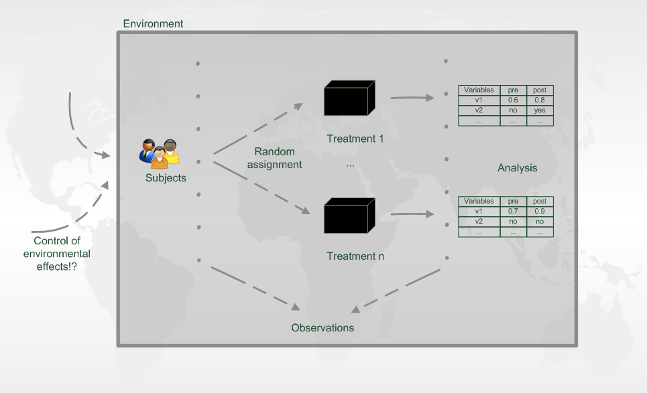
Experiment designs

Slide 7
Evaluation in information retrieval (IR)
Historical Cranfield collection (late 1950s)
1,398 journal article abstracts
225 queries
Exhaustive relevance judgements (over 300K)
Ground truth established by human domain experts
 |  | Reality
 |  | Actually Good | Actually Bad
Prediction | Rated Good | True Positive (tp) | False Positive (fp)
 | Rated Bad | False Negative (fn) | True Negative (tn)
All recommended items
All good items

Slide 8

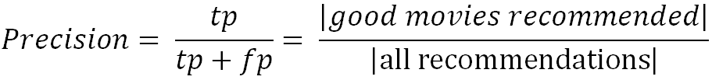
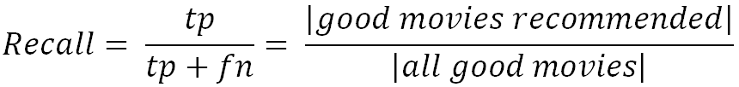
Metrics: Precision and Recall
Recommendation is viewed as information retrieval task:
Retrieve (recommend) all items which are predicted to be “good”.
Precision: a measure of exactness, determines the fraction of relevant items retrieved out of all items retrieved
E.g. the proportion of recommended movies that are actually good
Recall: a measure of completeness, determines the fraction of relevant items retrieved out of all relevant items
E.g. the proportion of all good movies recommended

Slide 9
Precision vs. Recall
E.g. typically when a recommender system is tuned to increase precision, recall decreases as a result (or vice versa)

Slide 10
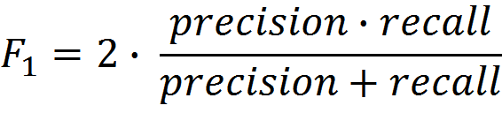
F₁ Metric
The F₁ Metric attempts to combine Precision and Recall into a single value for comparison purposes.
May be used to gain a more balanced view of performance
The F₁ Metric gives equal weight to precision and recall
Other F_{β} metrics weight recall with a factor of β.

Slide 11
Metrics: Rank position matters
For a user:
Actually good
Item 237
Item 899
Recommended (predicted as good)
Item 345
Item 237
Item 187
hit
Rank metrics extend recall and precision to take the positions of correct items in a ranked list into account
Relevant items are more useful when they appear earlier in the recommendation list
Particularly important in recommender systems as lower ranked items may be overlooked by users

Slide 12
Metrics: Rank Score
Rank Score extends the recall metric to take the positions of correct items in a ranked list into account
Particularly important in recommender systems as lower ranked items may be overlooked by users
Rank Score is defined as the ratio of the Rank Score of the correct items to best theoretical Rank Score achievable for the user, i.e.
Where:
h is the set of correctly recommended items, i.e. hits
rank returns the position (rank) of an item
T is the set of all items of interest
α is the ranking half life, i.e. an exponential reduction factor

Slide 13
Metrics: Liftindex
Assumes that ranked list is divided into 10 equal deciles S_{i}, where
Linear reduction factor
Liftindex:
h is the set of correct hits

Slide 14
Metrics: Normalized Discounted Cumulative Gain
Discounted cumulative gain (DCG)
Logarithmic reduction factor
Idealized discounted cumulative gain (IDCG)
Assumption that items are ordered by decreasing relevance
Normalized discounted cumulative gain (nDCG)
Normalized to the interval [0..1]
Where:
pos denotes the position up to which relevance is accumulated
rel_{i} returns the relevance of recommendation at position i

Slide 15
Example
Assumptions:
|T| = 3
Ranking half life (alpha) = 2
Rank | Hit?
1
2 | X
3 | X
4 | X
5

Slide 16
Example cont.
Reducing the ranking half life (alpha) = 1
Rankscore (exponential reduction) < Liftscore (linear red.) < NDCG (log. red.)
Rank | Hit?
1
2 | X
3 | X
4 | X
5

Slide 17
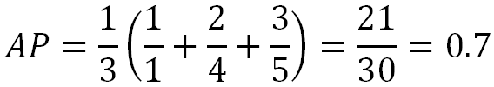

Average Precision
Average Precision (AP) is a ranked precision metric that places emphasis on highly ranked correct predictions (hits)
Essentially it is the average of precision values determined after each successful prediction, i.e.
Rank | Hit?
1
2 | X
3 | X
4 | X
5
Rank | Hit?
1 | X
2
3
4 | X
5 | X

Slide 18
Evaluation in RS
Datasets with items rated by users
MovieLens datasets 100K-10M ratings
Netflix 100M ratings
Historic user ratings constitute ground truth
Metrics measure error rate
Mean Absolute Error (MAE) computes the deviation between predicted ratings and actual ratings
Root Mean Square Error (RMSE) is similar to MAE, but places more emphasis on larger deviation

Slide 19
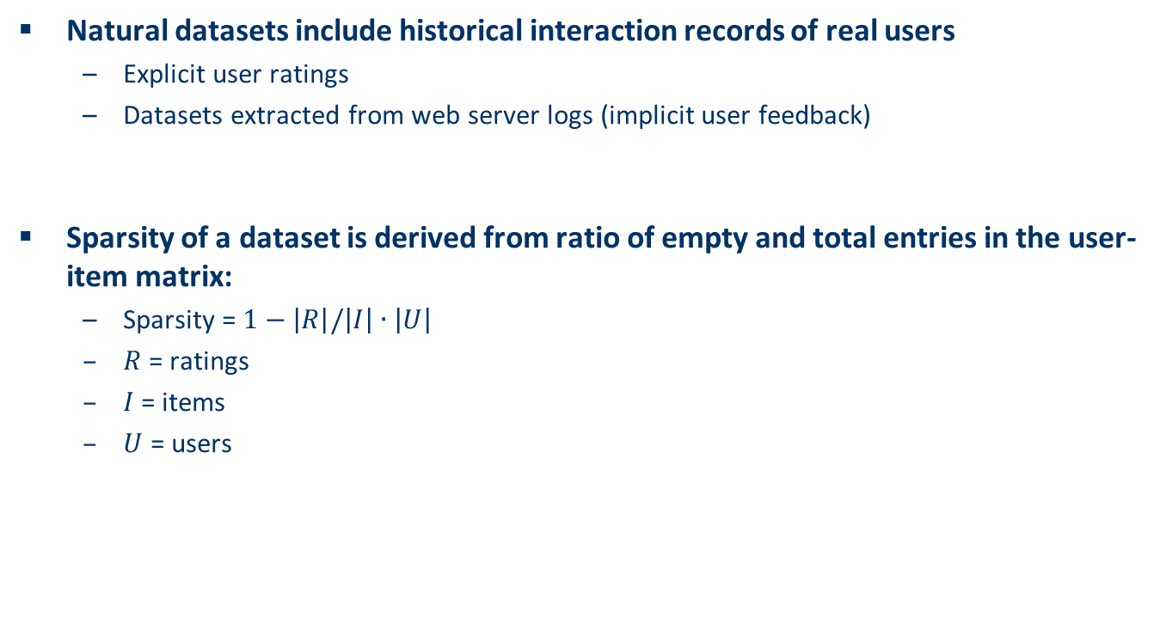
Data sparsity
Natural datasets include historical interaction records of real users
Explicit user ratings
Datasets extracted from web server logs (implicit user feedback)
Sparsity of a dataset is derived from ratio of empty and total entries in the user-item matrix:
Sparsity = $1−\left|R\right|/\left|I\right|∙\left|U\right|$
$R$ = ratings
$I$= items
$U$ = users

Slide 20
Example
Nr. | UserID | MovieID | Rating (r_{i}) | Prediction (p_{i}) | |p_{i}-r_{i}| | (p_{i}-r_{i})²
1 | 1 | 134 | 5 | 4.5 | 0.5 | 0.25
2 | 1 | 238 | 4 | 5 | 1 | 1
3 | 1 | 312 | 5 | 5 | 0 | 0
4 | 2 | 134 | 3 | 5 | 2 | 4
5 | 2 | 767 | 5 | 4.5 | 0.5 | 0.25
6 | 3 | 68 | 4 | 4.1 | 0.1 | 0.01
7 | 3 | 212 | 4 | 3.9 | 0.1 | 0.01
8 | 3 | 238 | 3 | 3 | 0 | 0
9 | 4 | 68 | 4 | 4.2 | 0.2 | 0.04
10 | 4 | 112 | 5 | 4.8 | 0.2 | 0.04
 |  |  |  |  | 4.6 | 5.6
MAE = 0.46
RMSE = 0.75
Removing line nr. 4
MAE = 0.29
RMSE = 0.42
Removing lines 1,2,4,5
MAE = 0.1
RMSE = 0.13

Slide 21
Dilemma of establishing ground truth
IR measures are frequently applied, however:
Offline experimentation | Online experimentation
Ratings, transactions | Ratings, feedback
Historic session (not all recommended items are rated) | Live interaction (all recommended items are rated)
Ratings of unrated items unknown, but interpreted as “bad” (default assumption, user tend to rate only good items) | “Good/bad” ratings of not recommended items are unknown
If default assumption does not hold: True positives may be too small False negatives may be too small | False/true negatives cannot be determined
Precision may increase Recall may vary | Precision ok Recall questionable
Results from offline experimentation have limited predictive power for online user behavior.

Slide 22
Offline experimentation
Netflix competition
Web-based movie rental
Prize of $1,000,000 for accuracy improvement (RMSE) of 10% compared to own Cinematch system.
Historical dataset
~480K users rated ~18K movies on a scale of 1 to 5
~100M ratings
Last 9 ratings/user withheld
Probe set – for teams for evaluation
Quiz set – evaluates teams’ submissions for leaderboard
Test set – used by Netflix to determine winner

Slide 23
Methodology
Setting to ensure internal validity:
One randomly selected share of known ratings (training set) used as input to train the algorithm and build the model
Model allows the system to compute recommendations at runtime
Remaining share of withheld ratings (testing set) required as ground truth to evaluate the model’s quality
To ensure the reliability of measurements the random split, model building and evaluation steps are repeated several times
N-fold cross validation is a stratified random selection procedure
N disjunct fractions of known ratings with equal size (1/N) are determined
N repetitions of the model building and evaluation steps, where each fraction is used exactly once as a testing set while the other fractions are used for training
Setting N to 5 or 10 is popular

Slide 24
Analysis of results
Are observed differences statistically meaningful or due to chance?
Standard procedure for testing the statistical significance of two deviating metrics is the pairwise analysis of variance (ANOVA)
Null hypothesis H₀: observed differences have been due to chance
If outcome of test statistics rejects H₀, significance of findings can be reported
Practical importance of differences?
Size of the effect and its practical impact
External validity or generalizability of the observed effects

Slide 25
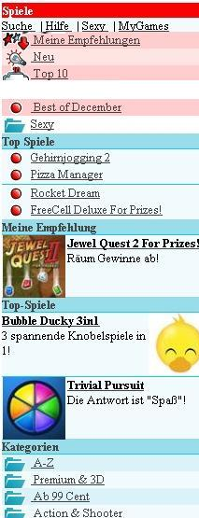
Online experimentation
Effectiveness of different algorithms for recommending cell phone games [Jannach, Hegelich 09]
Involved 150,000 users on a commercial mobile internet portal
Comparison of recommender methods
Random assignment of users to a specific method

Slide 26
Experimental Design
A representative sample 155,000 customers were extracted from visitors to site during the evaluation period
These were split into 6 groups of approximately 22,300 customers
Care was taken to ensure that customer profiles contained enough information (ratings) for all variants to make a recommendation
Groups were chosen to represent similar customer segments
A catalog of 1,000 games was offered
A five-point ratings scale ranging from -2 to +2 was used to rate items
Due to the low number of explicit ratings, a click on the “details” link for a game was interpreted as an implicit “0” rating and a purchase as a “1” rating
Hypotheses on personalized vs. non-personalized recommendation techniques and their potential to
Increase conversion rate (i.e. the share of users who become buyers)
Stimulate additional purchases (i.e. increase the average shopping basket size)

Slide 27
Non-experimental research
Quasi-experiments
Lack random assignments of units to different treatments
Non-experimental / observational research
Surveys / Questionnaires
Longitudinal research
Observations over long period of time
E.g. customer life-time value, returning customers
Case studies
Focus on answering research questions about how and why
E.g. answer questions like: How recommendation technology contributed to Amazon.com‘s becomes the world‘s largest book retailer?
Focus group
Interviews
Think aloud protocols

Slide 28
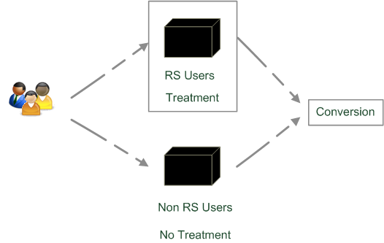
Quasi-experimental
SkiMatcher Resort Finder introduced by Ski-Europe.com to provide users with recommendations based on their preferences
Conversational RS
question and answer dialog
matching of user preferences with knowledge base
Delgado and Davidson evaluated the effectiveness of the recommender over a 4 month period in 2001
Classified as a quasi-experiment as users decide for themselves if they want to use the recommender or not

Slide 29
SkiMatcher Results
 | July | August | September | October
Unique Visitors | 10,714 | 15,560 | 18,317 | 24,416
SkiMatcher Users | 1,027 | 1,673 | 1,878 | 2,558
Non-SkiMatcher Users | 9,687 | 13,887 | 16,439 | 21,858
Requests for Proposals | 272 | 506 | 445 | 641
SkiMatcher Users | 75 | 143 | 161 | 229
Non-SkiMatcher Users | 197 | 363 | 284 | 412
Conversion | 2.54% | 3.25% | 2.43% | 2.63%
SkiMatcher Users | 7.30% | 8.55% | 8.57% | 8.95%
Non-SkiMatcher Users | 2.03% | 2.61% | 1.73% | 1.88%
Increase in Conversion | 359% | 327% | 496% | 475%
[Delgado and Davidson, ENTER 2002]

Slide 30
Interpreting the Results
The nature of this research design means that questions of causality cannot be answered (lack of random assignments), such as
Are users of the recommender systems more likely convert?
Does the recommender system itself cause users to convert?
Some hidden exogenous variable might influence the choice of using RS as well as conversion.
However, significant correlation between using the recommender system and making a request for a proposal
Size of effect has been replicated in other domains
Tourism
Electronic consumer products

Slide 31
What is popular?
Evaluations on historical datasets measuring accuracy
Most popular datasets
Movies (MovieLens, EachMovie, Netflix)
Web 2.0 platforms (tags, music, papers, …)
Most popular measures for accuracy
Precision/Recall
Items are classified as good or bad
MAE (Mean Absolute Error), RMSE (Root Mean Squared Error)
Items are rated on a given scale
Availability of data heavily biases what is done
Tenor at RecSys conferences to foster live experiments
Public infrastructures to enable A/B tests

Slide 32
What is popular? cont.
Quantitative survey in the literature
High ranked journal on IS and IR
ACM Transactions on Information Systems
Evaluation designs ACM TOIS 2004-2010
In total 15 articles on RS
Nearly 50% movie domain
80% offline experimentation
2 user experiments under lab conditions
1 qualitative research

Slide 33
Discussion & summary
General principles of empirical research an current state of practice in evaluating recommendation techniques were presented
Focus on how to perform empirical evaluations on historical datasets
Discussion about different methodologies and metrics for measuring the accuracy or coverage of recommendations.
Overview of which research designs are commonly used in practice.
From a technical point of view, measuring the accuracy of predictions is a well accepted evaluation goal
but other aspects that may potentially impact the overall effectiveness of a recommendation system remain largely under developed.

